Slide 1
Name: mohan Kumar
College code:6202
Regester number:620221104017

Slide 2
Abstract
It seems like you’re asking for help with abstracting or summarizing a topic related to reservations.
Could you please provide more context or specify what kind of reservations you’re referring to?
This could include hotel reservations, restaurant reservations, event reservations, or something else entirely

Slide 3
Problem statement
.could encompass various challenges such as inefficient booking systems, overbooking issues
.Identifying the specific issues you’re facing within the context of reservations would help in providing a more targeted problem statement.
.Difficulty in managing cancellations or modifications, or inadequate customer satisfaction due to long waiting times or inaccurate information.

Slide 4
Project overview
.The project would aim to improve efficiency, accuracy, and customer satisfaction while reducing manual effort and operational costs associated with managing reservations.
.Integration with payment gateways, and reporting capabilities for tracking reservations and analyzing trends.
.A project overview for a reservation system could entail designing, developing, and implementing a robust booking platform to streamline the reservation process for a specific industry such as hotels, restaurants, or event venues.

Slide 5
TecHnoloGy View
Security Measures: Implementation of security protocols such as HTTPS, data encryption, and user authentication to protect sensitive information and ensure secure transactions.
Mobile Compatibility: Building mobile-friendly interfaces or developing dedicated mobile apps to enable customers to make reservations using smartphones or tablets.
Analytics and Reporting Tools: Integration with analytics tools like Google Analytics or custom reporting functionalities to track reservation metrics, analyze trends, and make data-driven decisions.

Slide 6
ModelIng & result
Could you please provide more context or specify what kind of modeling and results
It seems like you’re asking about modeling and obtaining results through reservation systems.
Referring to within the context of reservation systems?

Slide 7
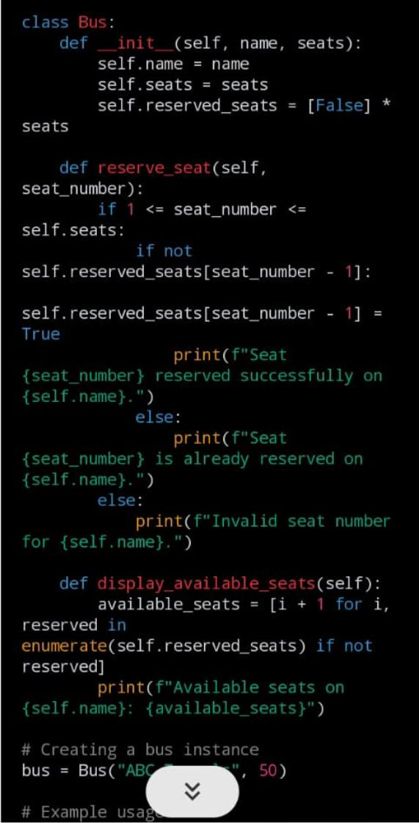
Screenshot

Slide 8
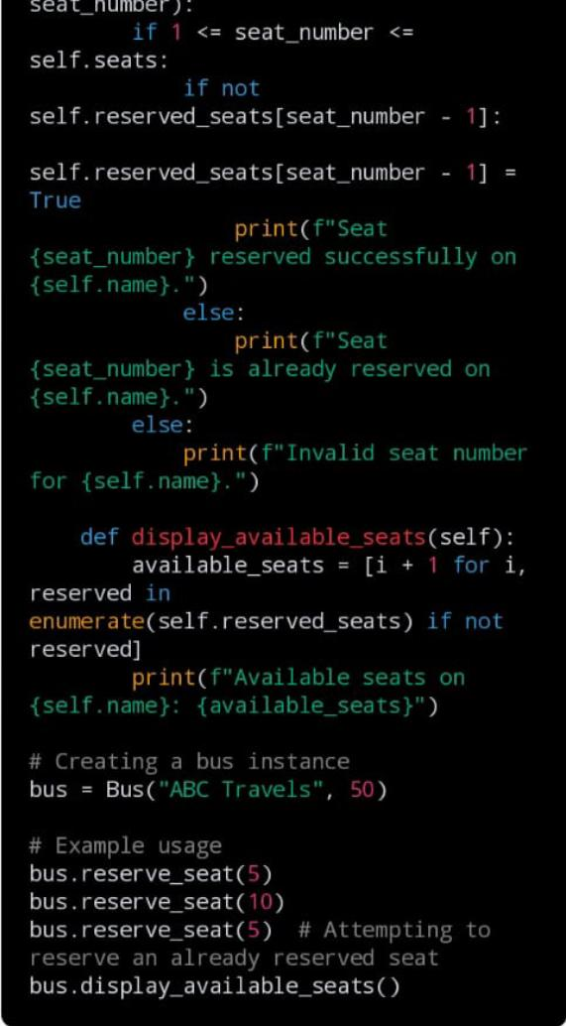
.

Slide 9
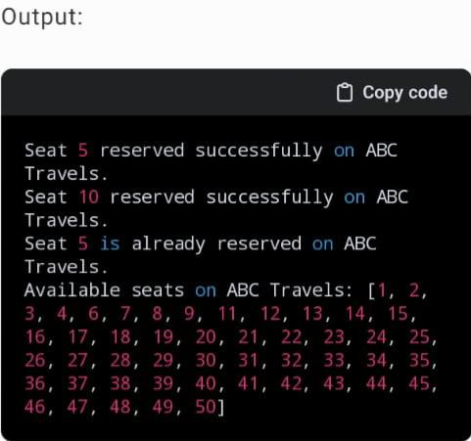
.

Slide 10
Future EnhaNcement
Could you please provide more details or clarify your request?
Do you have a specific aspect of reservation that you’d like to enhance?
Are you asking about potential future enhancements to a reservation

Slide 11
ConCluRioN
Reservations are crucial in various industries, including hospitality, travel, and dining, as they ensure efficient use of resources and provide convenience for both businesses and customers.
Integrating with other technologies such as AI chatbots for customer support.
It sounds like you’re asking for a conclusion or summary regarding reservations.

Slide 12
thank yoU

